Slide 1
PRESENTATION ON
FOOD WASTE MANAGEMENT SYSTEM DESIGN

Slide 2
AGENDA
Introduction​
Tools use to create diagrams
Primary goals
​diagrams
​relationships use in this diagrams
Importance of diagram to system

Slide 3
Introduction
Unified Modeling Language (UML) diagrams are a type of visual representation used to model software systems and processes. UML is a standardized language used by software developers, system architects, and business analysts to communicate and document their designs and ideas. UML diagrams provide an abstract view of the system or process being modeled, allowing stakeholders to better understand its structure, behavior, and interactions.

Slide 4
Tools use to create the diagrams
1 modelio
starUML
Visual paradigm
lucidchart

Slide 5
PRIMARY GOALS
the primary goal of UML design for a food waste management system software is to provide a clear and concise visualization of the system's requirements and design, which can help to ensure that the system meets the needs of its users and stakeholders, and is efficient, effective, and sustainable.

Slide 6
1. Class Diagram: A class diagram is a type of structural diagram that shows the classes, interfaces, and their relationships to each other. A class is a blueprint for creating objects, and it defines the properties and methods that the objects will have. - -

Slide 7
class diagrams relationships - -
Association: Association represents a relationship between two classes that indicates that one class is somehow related to the other class.
Aggregation: Aggregation represents a relationship where one class is composed of one or more objects of another class.
Composition: Composition represents a stronger form of aggregation where the objects that make up a class cannot exist independently of the class they belong to.
Inheritance: Inheritance represents a relationship where one class inherits properties and methods from another class.
Dependency: Dependency represents a relationship where one class depends on another class to perform some action or provide some service.

Slide 8
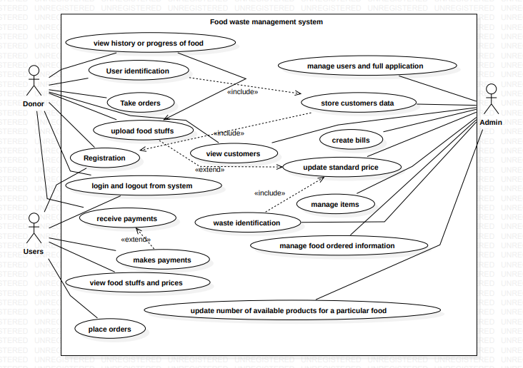
Use case diagrams: used to describe the interactions between a system and its users or other systems by modeling the different use cases and actors involved. - -

Slide 9
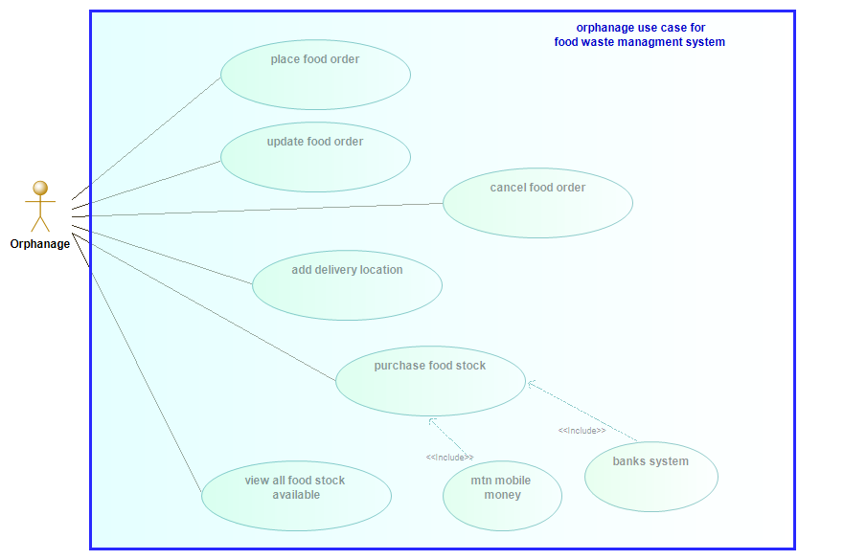
Orphanage use case

Slide 10
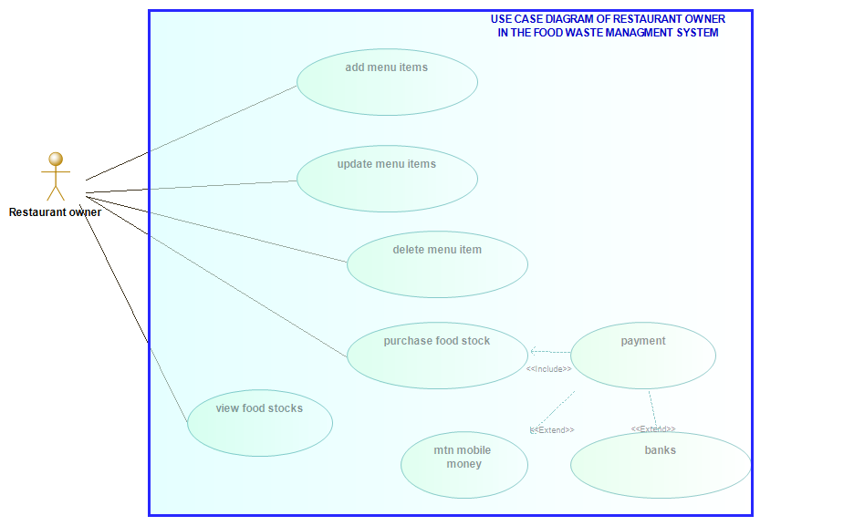
Restaurant owner use case

Slide 11
Use case diagrams relationships - -
Association An association is a relationship between two use cases that indicates that they are somehow related to each other
Generalization is a relationship between two use cases where one use case is a more specialized version of another use case
Include is a relationship between two use cases where one use case includes another use case as a part of its functionality.
Extend is a relationship between two use cases where one use case extends another use case by adding additional functionality.

Slide 12
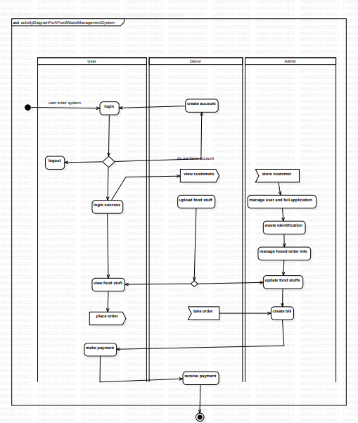
Activity diagrams: used to describe the flow of activities in a system or process, including the actions, decisions, and branching paths. - -

Slide 13
Activity diagrams relationships - -
Control Flow: Control flow represents the order in which activities are performed in a process or system.
Object Flow: Object flow represents the flow of objects or data between activities in a process or system.
Decision: Decision represents a branching point in a process or system where a decision must be made based on some condition.
Merge: Merge represents a point in a process or system where two or more paths converge back into a single path.
Fork: Fork represents a point in a process or system where a single path splits into two or more parallel paths.
Join: Join represents a point in a process or system where two or more parallel paths converge back into a single path

Slide 14
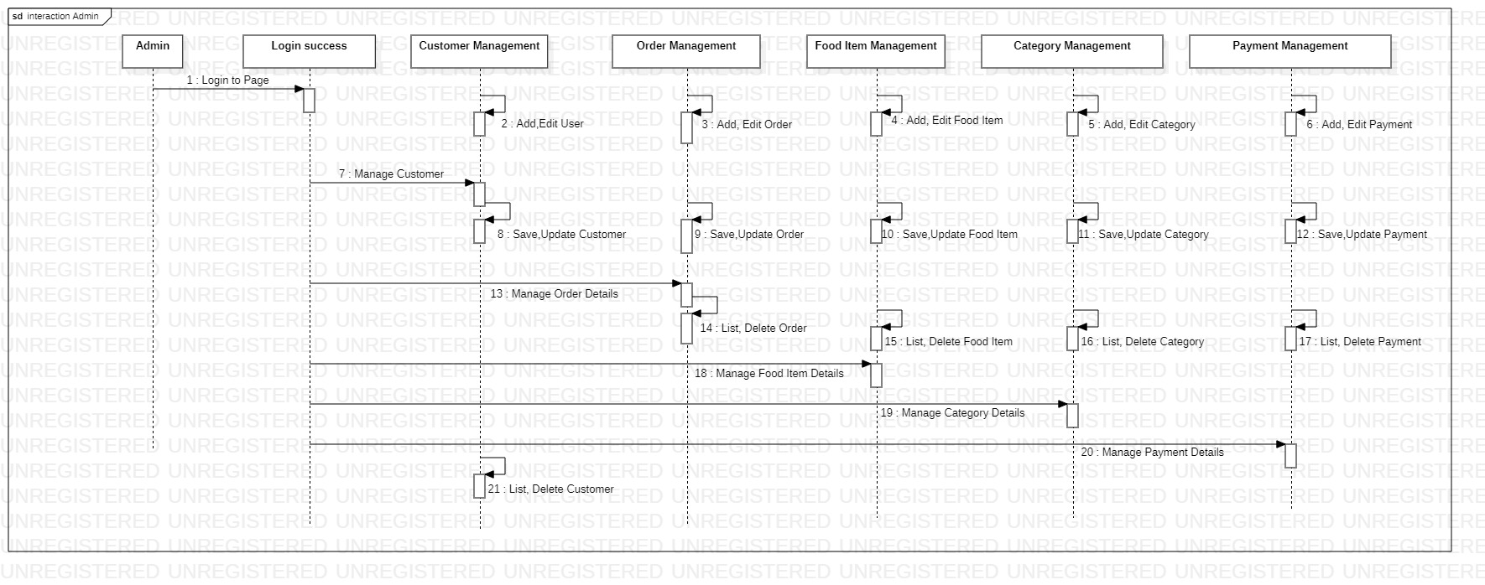
Sequence diagrams: used to describe the interactions between actors and objects in a system or process, including the messages exchanged and their order. - -

Slide 15
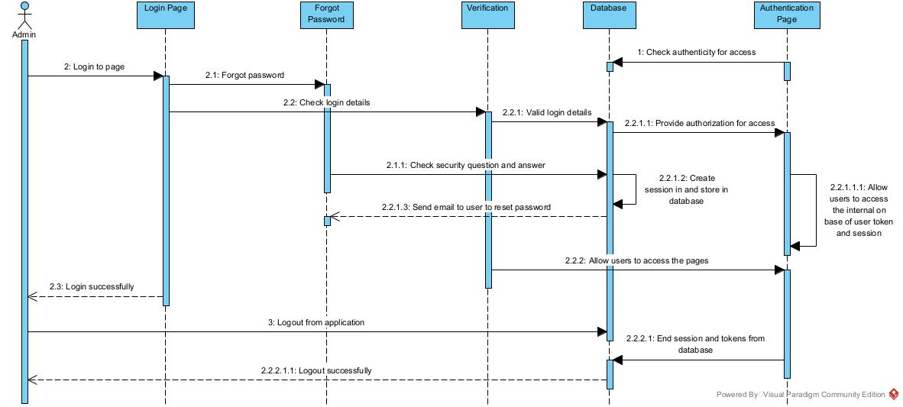
Login sequence diagram

Slide 16
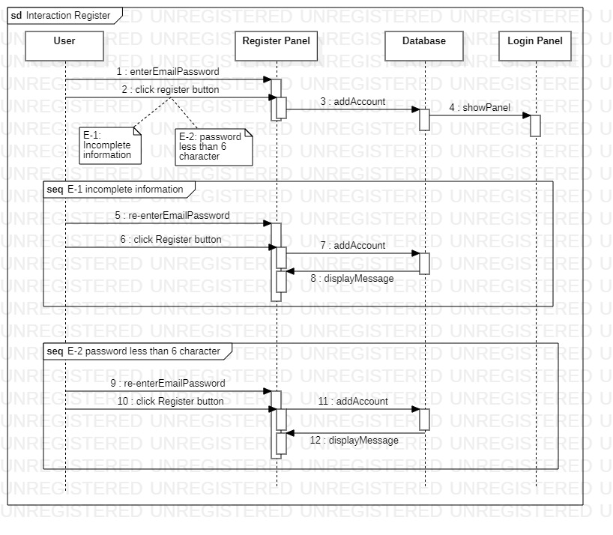
Register sequence diagram

Slide 17
Sequence diagrams relationships - -
Lifeline: Lifeline represents the existence of an object or participant in a sequence diagram.
Message: Message represents a communication or interaction between two objects or participants in a sequence diagram.
Self-message: Self-message represents a message sent by an object to itself in a sequence diagram.
Combined fragment: Combined fragment represents a grouping of messages in a sequence diagram, which can be used to represent conditions, loops, and other control structures.
Interaction use: Interaction use represents a reusable sequence of messages in a sequence diagram.
Return message: Return message represents a message sent from a called

Slide 18
Importance of class diagram
Helps to represent the structure of a software system.
Provides a visual representation of the relationships between different classes and objects.
Helps to identify the attributes, operations, and methods of each class.
Helps to identify the inheritance hierarchy and dependencies between classes.
Helps to communicate the design of a software system to stakeholders.

Slide 19
Importance of use case diagram
Helps to represent the functionality of a software system.
Provides a visual representation of the interactions between different actors and use cases.
Helps to identify the different use cases and actors involved in a software system.
Helps to identify the relationships between different use cases, such as includes and extends.
Helps to communicate the requirements and design of a software system to stakeholders.

Slide 20
Importance of sequence diagram
Helps to represent the interactions and behaviors of objects or participants in a system or process.
Provides a visual representation of the messages exchanged between objects or participants.
Helps to identify the lifelines and activation periods of objects or participants.
Helps to identify the control structures, such as loops and conditions, in a system or process.
Helps to communicate the behavior and design of a system or process to stakeholders.

Slide 21
Importance of activity diagram
Helps to represent the flow and behavior of a process or system.
Provides a visual representation of the different activities and tasks involved in a process or system.
Helps to identify the decision points and control structures of a process or system.
Helps to identify the objects and data involved in a process or system.
Helps to communicate the behavior and design of a process or system to stakeholders.

Slide 22
THANK YOU
for your attention

